Slide 1
P5: Final Iteration
Team CAACC
Cole Juracek
Aaron Colborg
Austin Thompson
Chris Marques
Chris Yancey

Slide 2
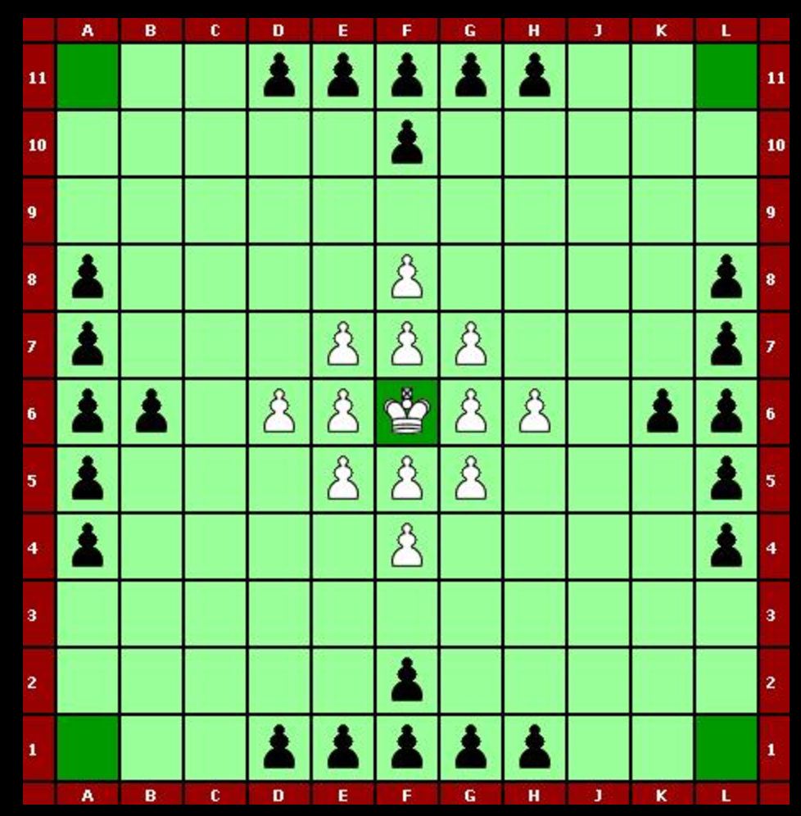
What is Hnefatafl?
The attackers (black) win by surrounding the white king on 4 sides.
The defenders (white) win by moving their king to the edge of the board.
Pieces move like rooks in chess; captures are made by “sandwiching” an enemy piece

Slide 3
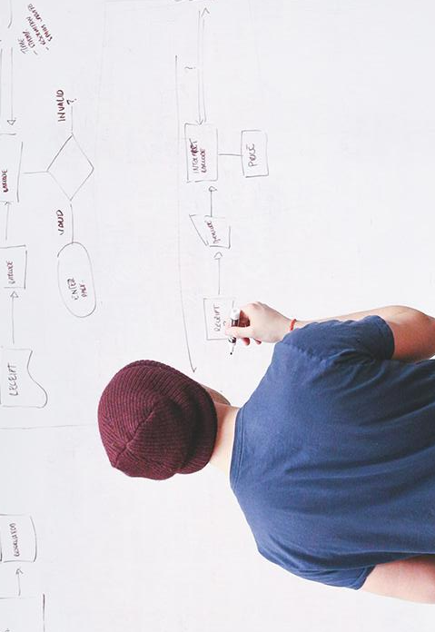
Document Updates
Now with more of them!

Slide 4
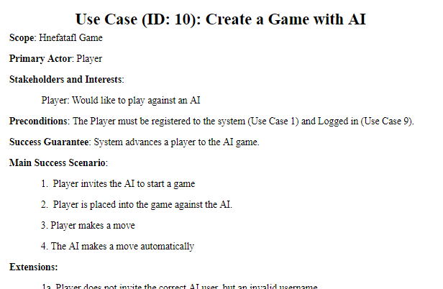
Use Cases, Domain Model, and Glossary
Began with 8 Use Cases, currently 10
Each Iteration adding and improving
Most recently updated with AI
Maintain consistency with project

Slide 5
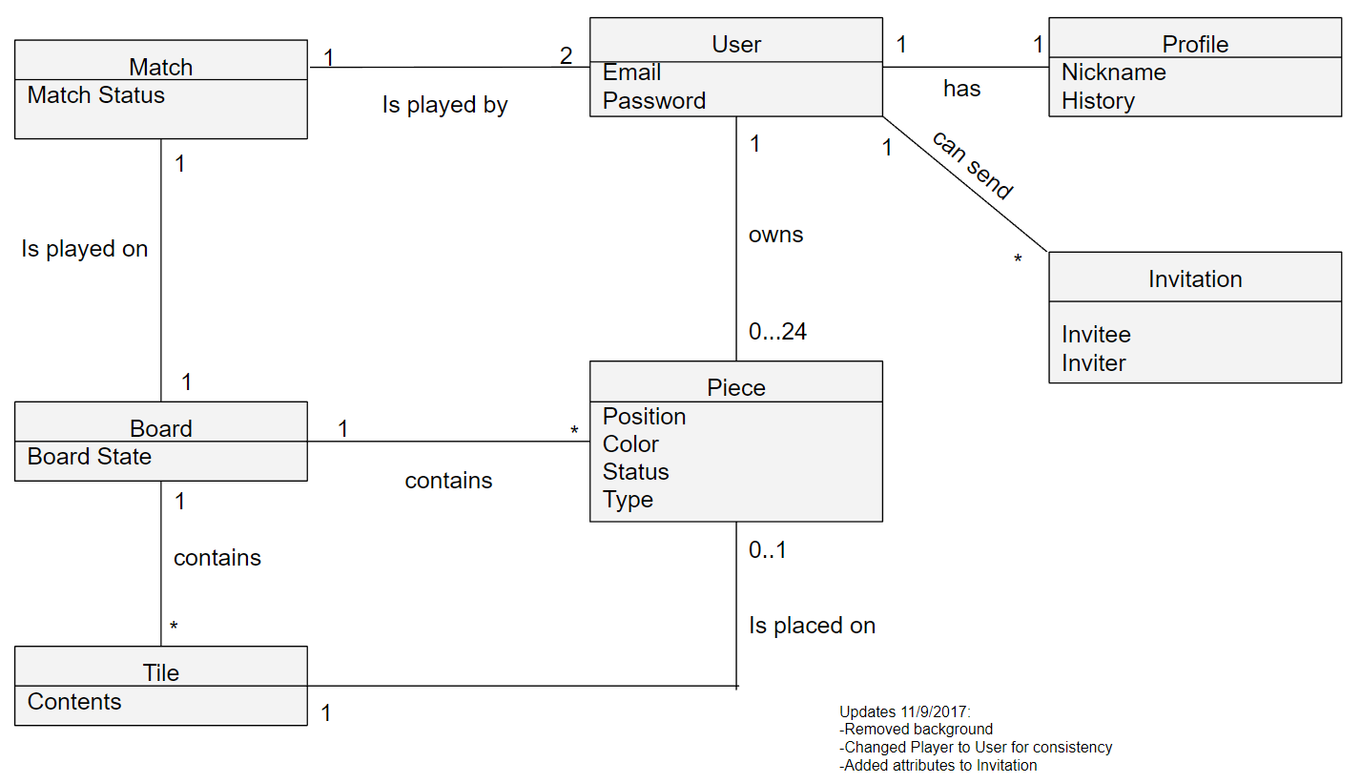
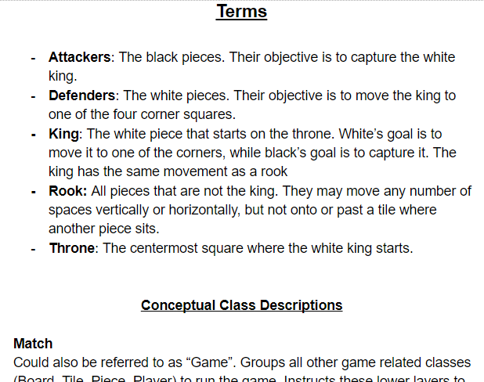
Use Cases, Domain Model, and Glossary
Domain Model and Glossary:
Consistently updated to better represent our Use Cases and new additions
As of now, accurately display and describe our initial concepts

Slide 6
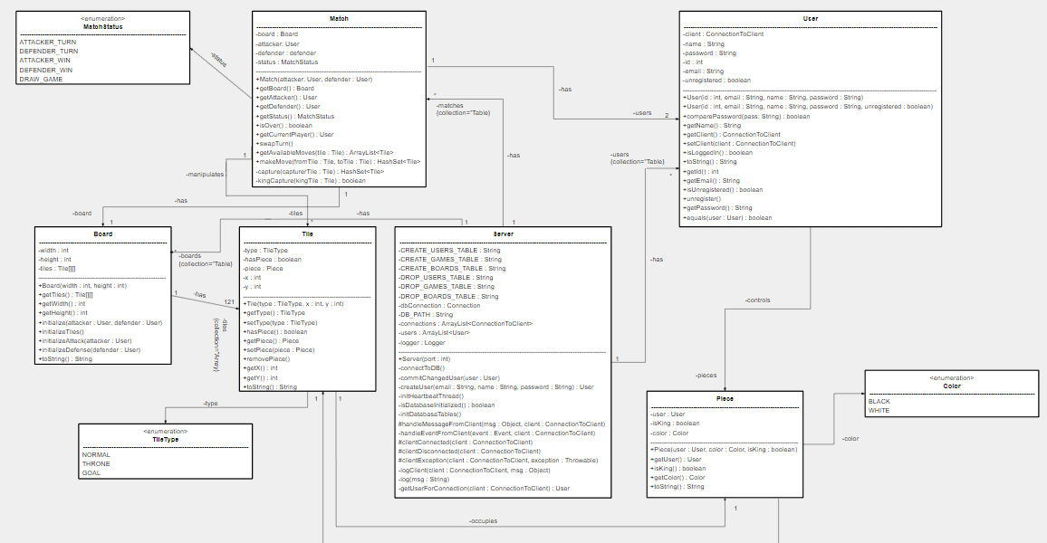
Design Class Diagram
Many… Many Changes
By far the most edited document
Was missing most all of the classes
Associations/Multiplicities were all over the place
Before...

Slide 7
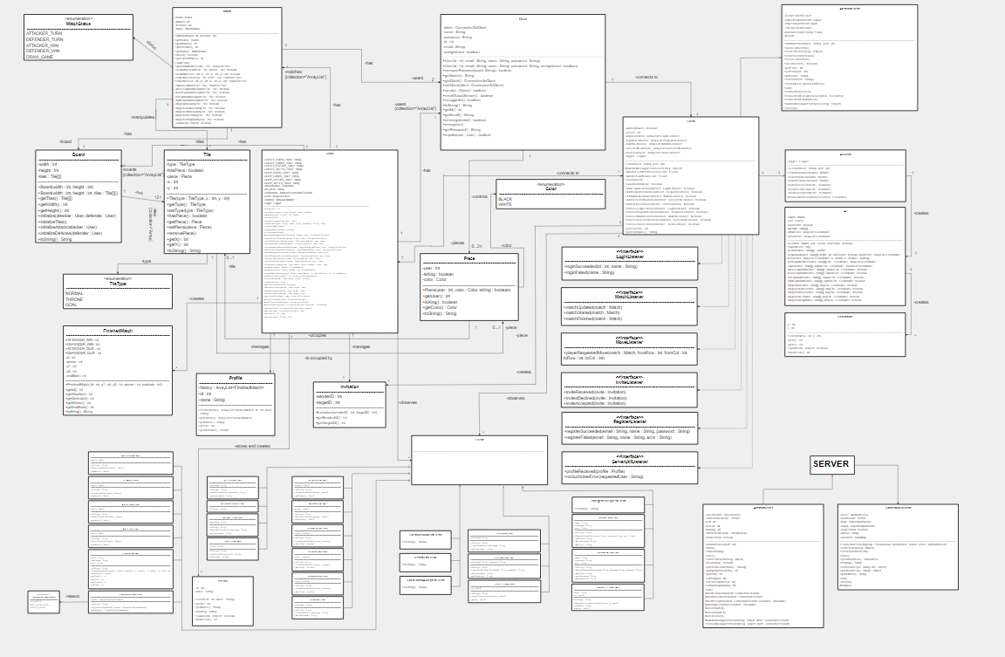
After!

Slide 8
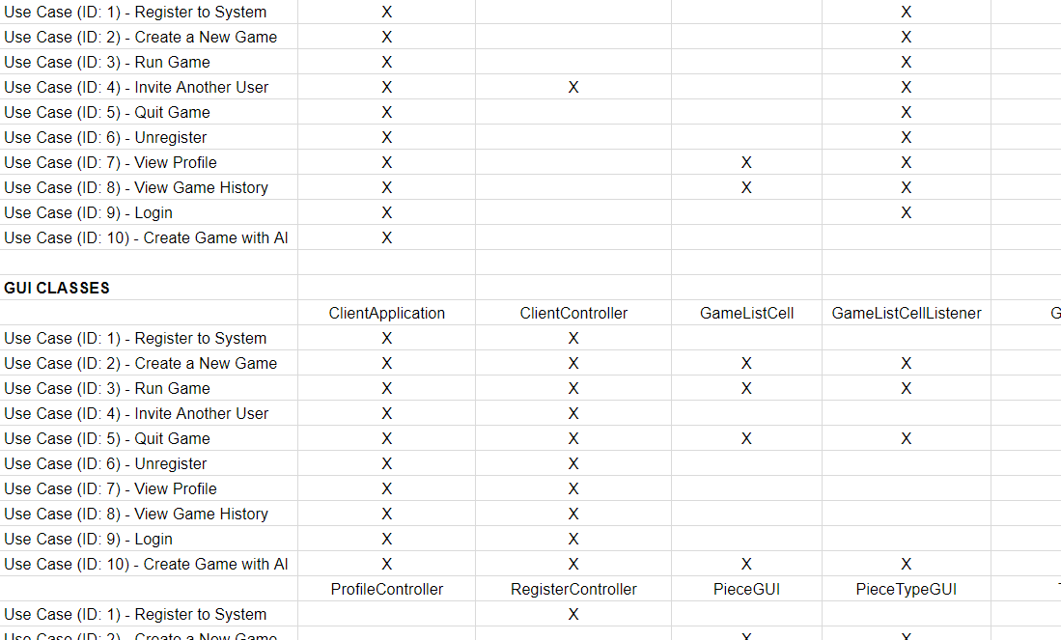
Traceability Link Matrix
Changes made:
Has been updated over time with new classes and use cases
As of now:
Removed “class groupings” in favor of class grouping headers.
Added ALL classes

Slide 9
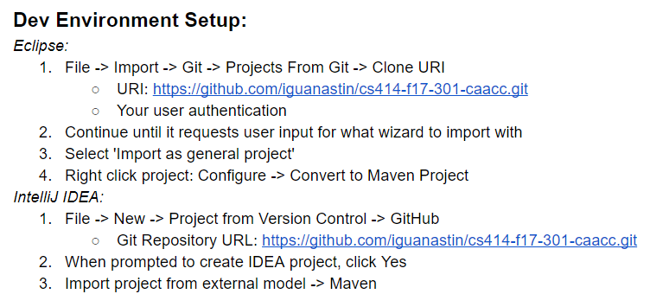
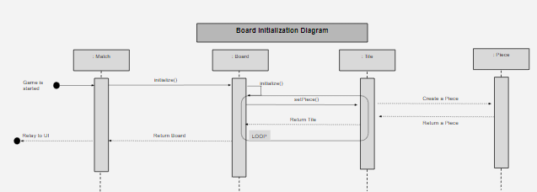
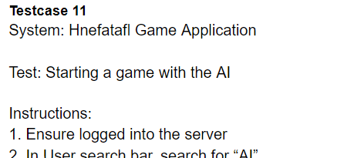
System Test Document, Sequence Diagrams, and Development Manual
Development Manual:
Ambiguous instructions
Sequence Diagram:
Kept up to date with many class structure changes
Test Document:
Added Test Cases and verbosity as features were added and feedback received

Slide 10
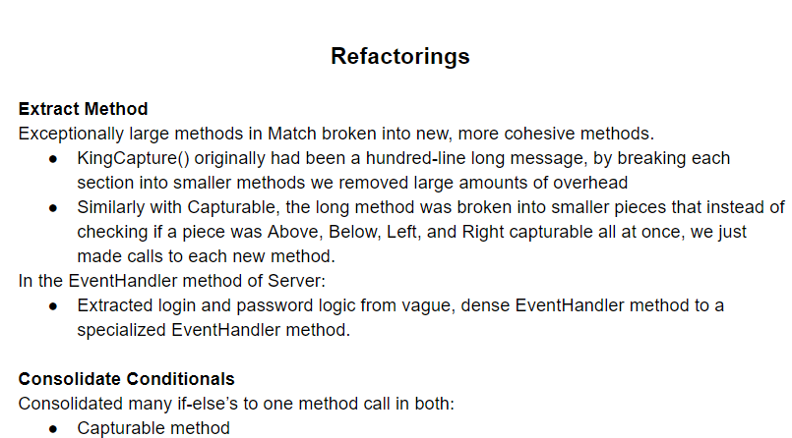
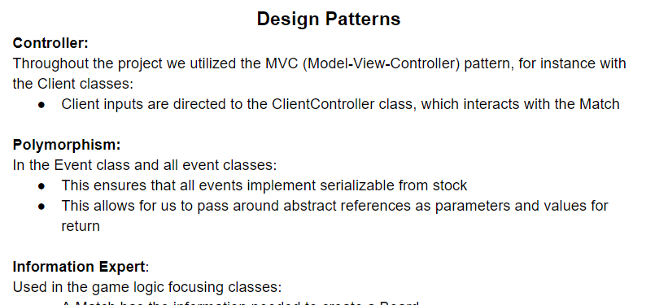
Refactoring/Pattern Document
Refactorings and Patterns:
Mentioned last iteration, missing the document
Extract Method
Model View Controller (MVC)

Slide 11
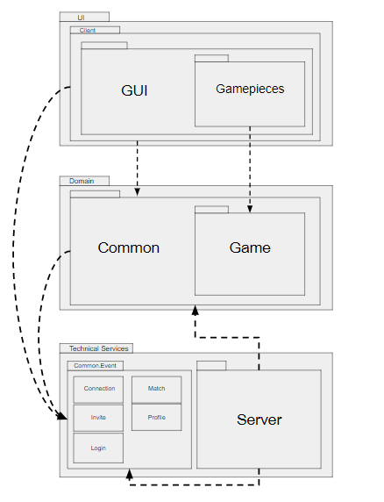
Package Diagram
Added subpackage interactions based on new feedback
Game Package at the UI layer changed to Gamepieces

Slide 12
Additional Requirement: AI
Negamax Search Algorithm
Explores future board states given a board state.
Searches 4 turns ahead before deciding on a move
Alpha-beta pruning
Heuristic Function
Priority 1 - The King
Priority 2 - Capturing Pieces
Priority 3 - Board Positioning

Slide 13
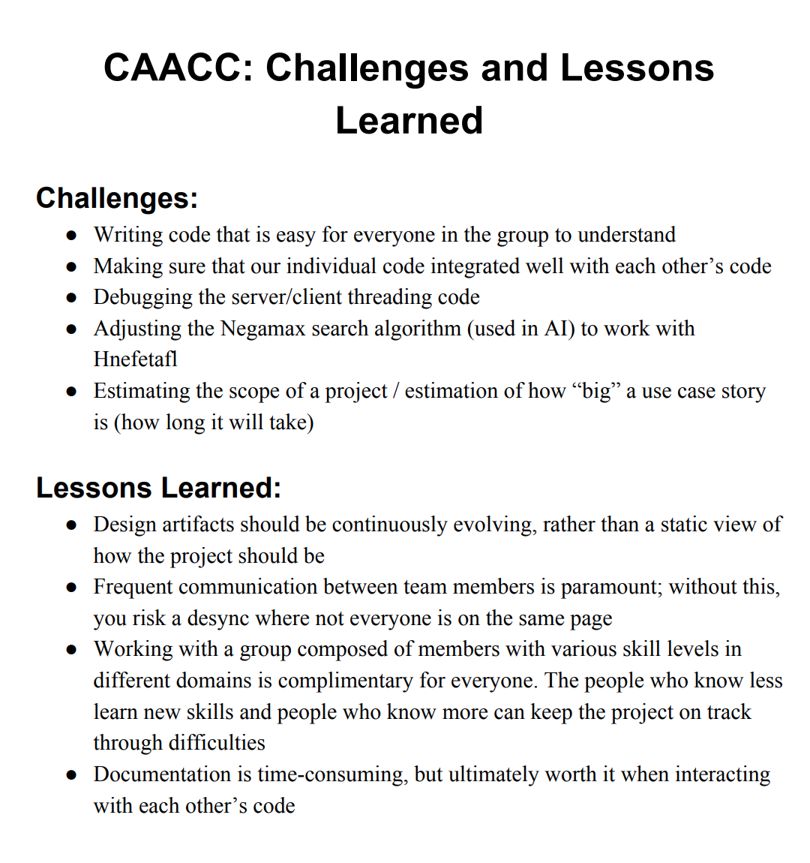
Challenges and Lessons Learned

Slide 14

And now for the DEMO!

